Slide 1
CoTaPP: Computational Thinking and Programming with Python
Module 1: Computational Thinking
9 February 2022

Slide 2
Course Administration
Lecturers:
Pablo Mosteiro (Wednesdays)
Isaac Alpizar-Chacon (Fridays)
Lab coordinator: Francisca Pessanha
Lab instructors:
Alec Noppe (lab A – BOL 1.075)
Stefan Stan (lab B – BOL 1.082)
Nathan Oerlemans (lab C – BOL 3.100)
Selim Buyuk (lab D – BOL 0.204)
Guanyi Chen (lab E – online)

Slide 3
Q&A Sessions
Alec: Monday 17:15-19:00
Selim: Tuesday 9:15-11:00
Guanyi: Tuesday 15:15-17:00
Nathan: Thursday 15:15-17:00
Stefan: Friday 11:15-13:00
Francisca, Isaac, Pablo: by email or by appointment

Slide 4
Important Dates
16/2 – 2/3: group project 1
2/3 – 16/3: group project 2
18/3: midterm exam (on campus)
16/3 – 30/3: group project 3
30/3 – 15/4: group project 4
13/4: final exam (on campus)

Slide 5
Module 1:
Computational Thinking

Slide 6
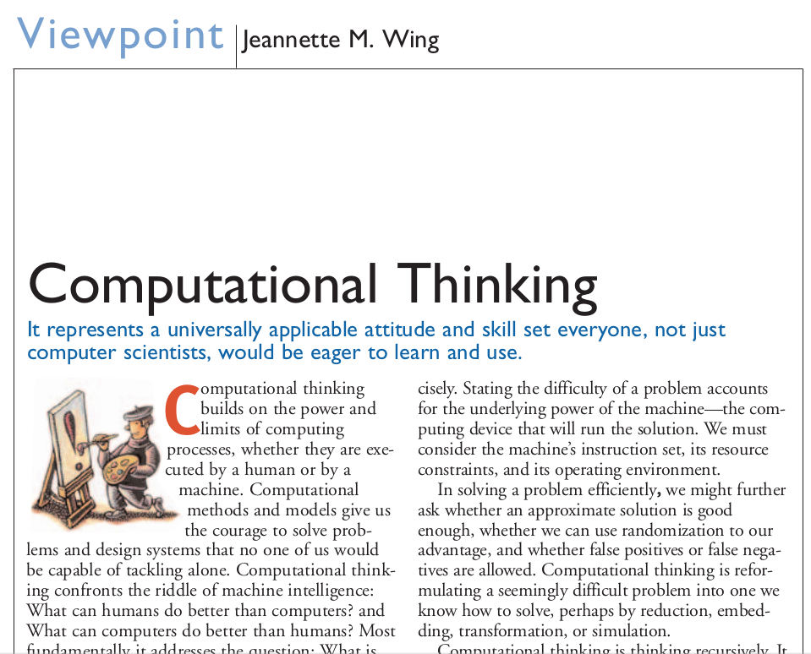
Module 1:
Computational Thinking

Slide 7
Giving Instructions
Take a piece of paper and a pen.
Draw a dot in the center of the page.
Draw a rectangle around the dot.
Write your name under the rectangle.

Slide 8
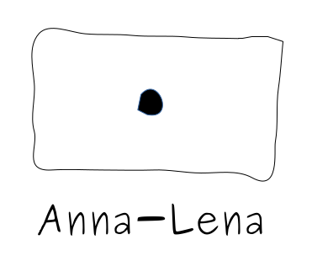
Giving Instructions
Take a piece of paper and a pen.
Draw a dot in the center of the page.
Draw a rectangle around the dot.
Write your name under the rectangle.
Pablo

Slide 9
Giving Instructions
Take a piece of paper and a pen.
Draw two dots close to each other.
Draw a short line.
Draw a U-shape.
Draw a circle around everything.

Slide 10
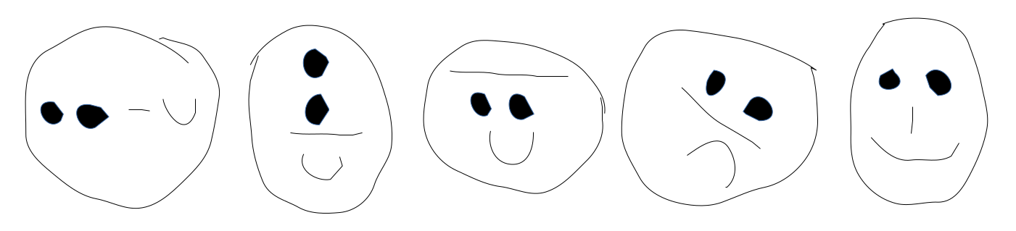
Giving Instructions
Take a piece of paper and a pen.
Draw two dots close to each other.
Draw a short line.
Draw a U-shape.
Draw a circle around everything.

Slide 11

Giving Instructions

Slide 12
Giving Instructions
1. forward(x)
2. left(x)
3. right(x)
4. jump(x,y)

Slide 13
Giving Instructions
forward(100)
jump(0,0)
left(45)
forward(100)
jump(0,0)
left(45)
forward(100)
jump(0,0)
left(45)
forward(100)
jump(0,0)
left(45)
forward(100)

Slide 14
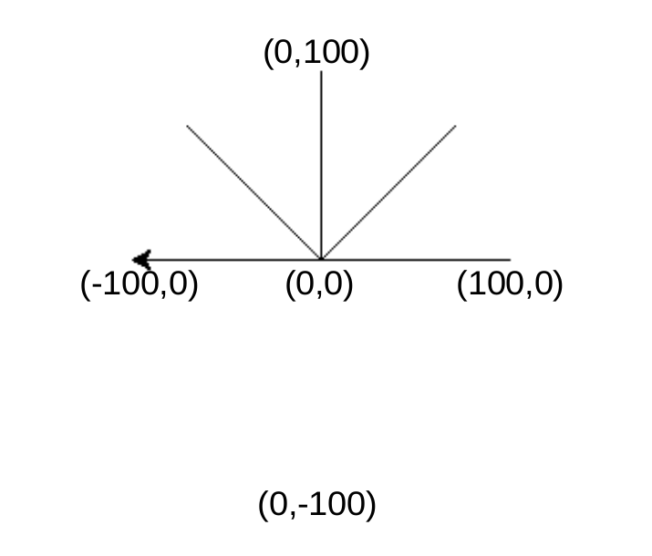
Giving Instructions
forward(100)
jump(0,0)
left(45)
forward(100)
jump(0,0)
left(45)
forward(100)
jump(0,0)
left(45)
forward(100)
jump(0,0)
left(45)
forward(100)

Slide 15
Giving Instructions
(0,10)
(10,10)
(0,0)
(10,0)

Slide 16
Giving Instructions
(0,10)
(10,10)
forward(10)
left(90)
forward(10)
left(90)
forward(10)
left(90)
forward(10)
(0,0)
(10,0)

Slide 17
Giving Instructions
(0,0)

Slide 18
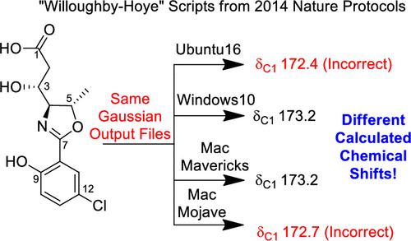
Giving Instructions
Org. Lett. 2019, 21, 20, 8449–8453

Slide 19
Exercise
forward(100)
left(120)
forward(100)
(0,0)
(0,0)
(0,0)

Slide 20
Exercise
forward(100)
left(120)
forward(100)
(0,0)
(0,0)
(0,0)

Slide 21
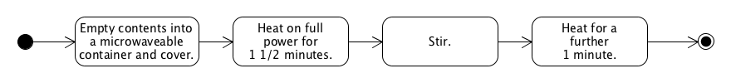
Next class
Activity Diagrams

